Slide 1
Setting up Category Weights in GradeBook

Slide 2
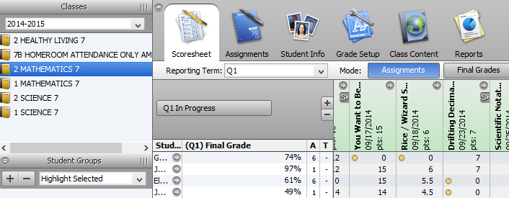
Click on the Grade Setup tab at the top of the screen.

Slide 3
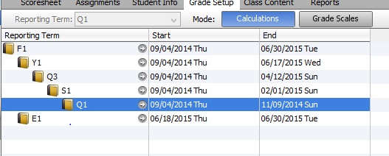
Double-click on Q1.

Slide 4
This opens the Q1 Final Grade Setup box.

Slide 5
Choose Category Weights.

Slide 6
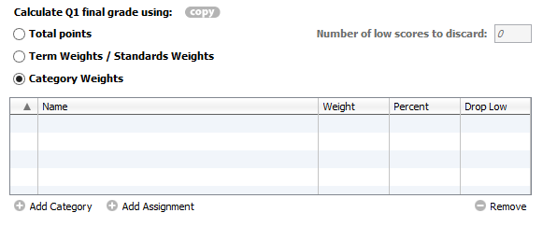
Click on Add Category.

Slide 7
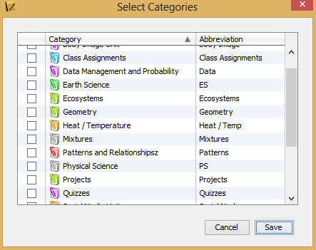
This opens a box of all of your created categories.

Slide 8
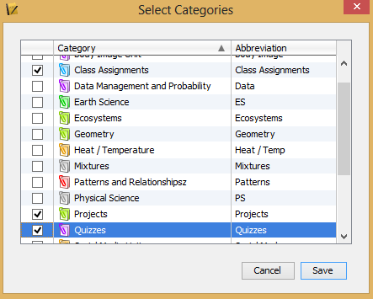
Choose the categories that you want included in your grade calculation.
Click Save.

Slide 9
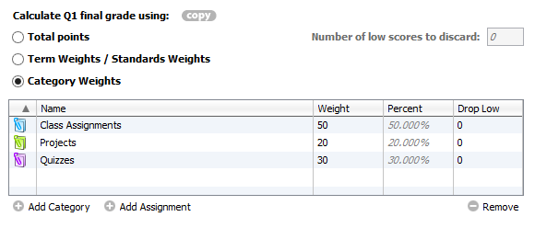
Enter the weight of each category.
Click Save.

Slide 10
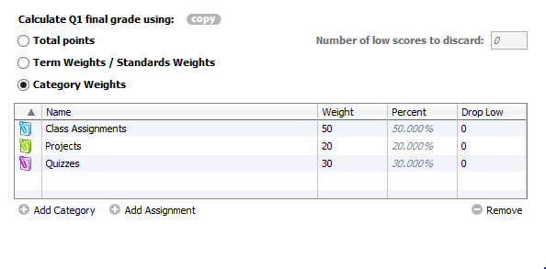
To copy this grade setup to other reporting terms, click Copy.

Slide 11
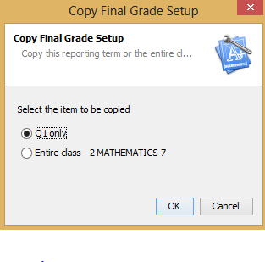
This box appears with Q1 selected. Click OK.

Slide 12
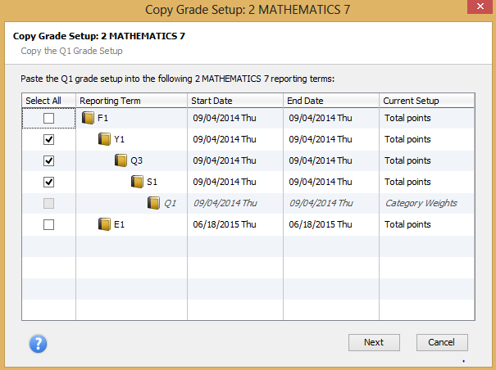
Choose the reporting terms you want to have the same category weights.
Click Next.

Slide 13
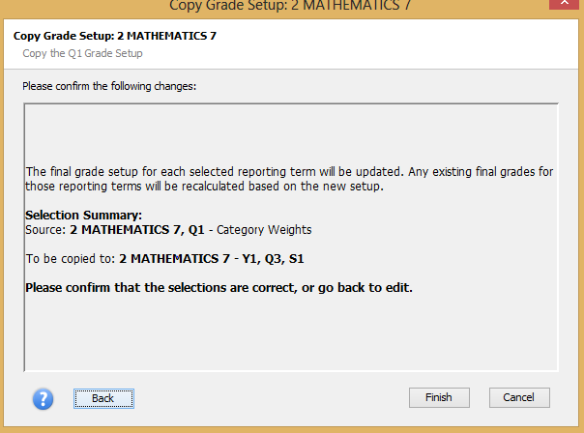
The following box appears. Click Finish.

Slide 14
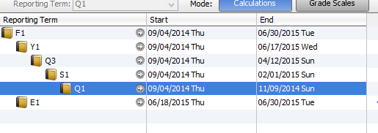
Click F1.

Slide 15
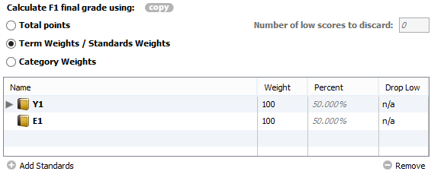
Choose Term Weights / Standards Weights.

Slide 16
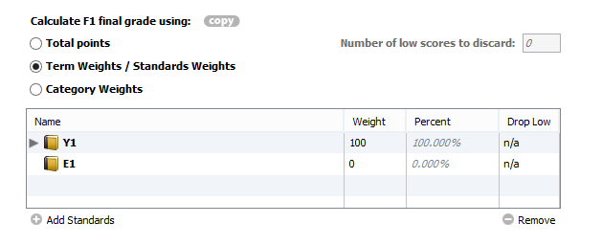
If your course has no exam in the exam period set Y1 = 100% and E1= 0%.
Click Save.

Slide 17
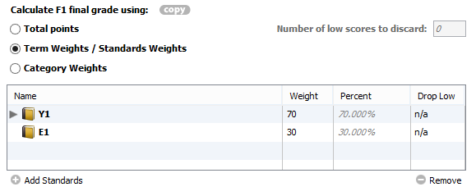
If your course has an exam in the exam period, set your Y1 and E1 percentages accordingly.
Click Save.

Slide 18
Your Grade Setup is now complete for your course!

